Slide 1
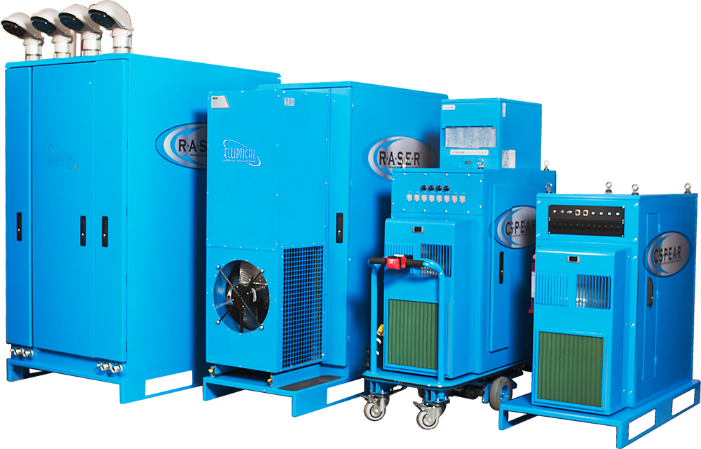
EMS Case Studies

Slide 2

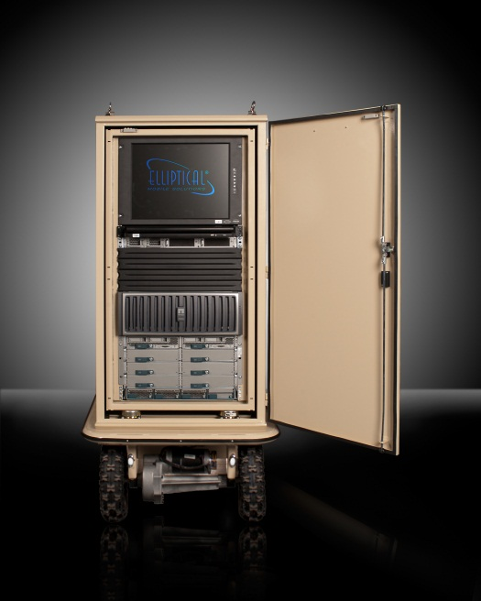
Mobile Hardened Infrastructure
NATO/OTAN
Intergovernmental Military Agency in need of infrastructure in harsh environments.
Challenges: NATO needed a data center to support a mobile communications platform. In the past, they had used hardened cases to house their IT. This meant they had to unplug and reconfigure their equipment every time they moved. Additionally, they were having cooling problems due to operating in harsh desert conditions.
Solution: Deploying two NEMA 4 C3-S.P.E.A.R.s for Rugged Terrain will allow NATO to consolidate multiple cases into two small data centers. The adaptive suspension features will allow them to move their data center without having to remove and reconfigure the equipment.
Benefits: Eliminated cooling issues; perfect plug and play data center; rapid deployment; scalability, easy to relocate.
Confidential 2012 – www.ellipticalmobilesolutions.com

Slide 3
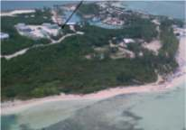
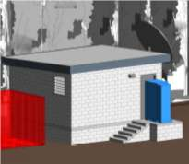
Data Center Retrofit
Large American Cruise Line
Large American Cruise Line in need of remote site Data Center.
Challenges: A Large US-Based Cruise Line was in need of a simple way to deploy their IT equipment at one of the many island ports. The way they deployed IT to these ports in the past was expensive and time consuming.
Solution: Working with RCCL architects, EMS helped to design a “hurricane proof server shack” at the Bahamas location that perfectly managed the environmental requirements for the product. Since RCCL could preconfigure the IT equipment in the US, RCCL was able to simply install the solution in the shack upon completion.
Benefits: Simplified and streamlined deployment due to preconfiguring each R.A.S.E.R. DX centrally and deploying remotely; Capital Expense savings, and environmentally sound in a harsh environment.
Confidential 2012 – www.ellipticalmobilesolutions.com

Slide 4

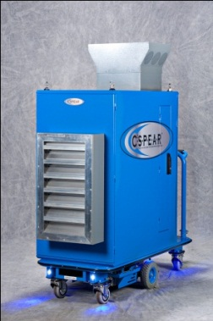
Remote Office Support
The Los Angeles County Superior Court
Largest trial court in the United States in need or remote office support
Challenge: Los Angeles County Superior Courts had a budget deficit with little money to spend while needing remote data centers for their court system. A strained California power grid provided constant problems to power and cooling of their existing data center.
Solution: The courts purchased six C3-S.P.E.A.R.s with Mission Critical Venting. This allowed them to eliminate downtime while providing remote offices with a secure, flexible infrastructure to protect their court records and data bases.
Benefits: Ability to deploy in historic building locations; rapid deployment in 10 weeks; cost savings; security; scalability for long term growth and mobility.
Confidential 2012– www.ellipticalmobilesolutions.com

Slide 5
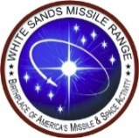
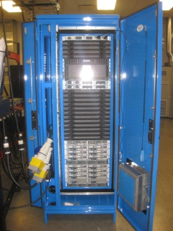
High Density Data Center Consolidation
White Sands Missile Range, New Mexico
U.S. Military Department in need of High Density Data Center.
Challenges: White Sands Missile Range needed to build a data center to support high density Cisco UCS and EMC without upgrading or modifying legacy traditional raised floor. They are planning to move in the next 24 months and wanted to go GREEN at the same time.
Solution: The R.A.S.E.R .DX allowed them to deploy a GREEN data center in under 8 weeks. The R.A.S.E.R .DX can be moved into a new facility without upgrading the new building and not having to un-rack and remount the IT equipment.
Benefits: Cost less than $90,000 to deploy $1.8 Million in new IT vs $900,000 to upgrade the entire facility; eliminated Crac units and chillers completely; UPS and generators can now support HVAC and IT load, and allowed client to upgrade everything within 10 weeks instead of 24-36 months.
Confidential 2012 – www.ellipticalmobilesolutions.com

Slide 6

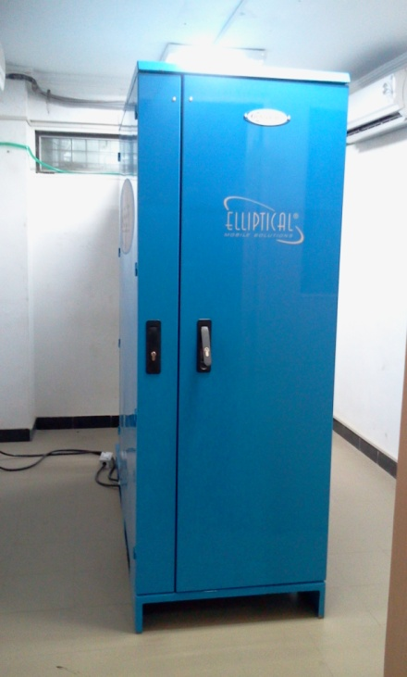
Bank Data Center
Co-Operative Bank, India
CKP Cooperative Bank, India needed a cost-effective data center that could move and expand upon rapid growth.
Challenges: CKP Co-operative Bank, India is a bank with 8 branches. They needed to build a data center, but their office is in leased premises and they have to move their office to new premises to accommodate the rapid growth of the bank. CKP co-op bank wanted a cost-effective data center that could move with them.
Solution: Deploying RASER DX allowed CKP to deploy a data center in one of their offices; they can easily relocate the data center to a bigger office space when needed.
Benefits: $100,000 Capex upfront saving ; scalability; security, and the ability to relocate the data center to a new location as the company grows.
Confidential 2012 – www.ellipticalmobilesolutions.com

Slide 7

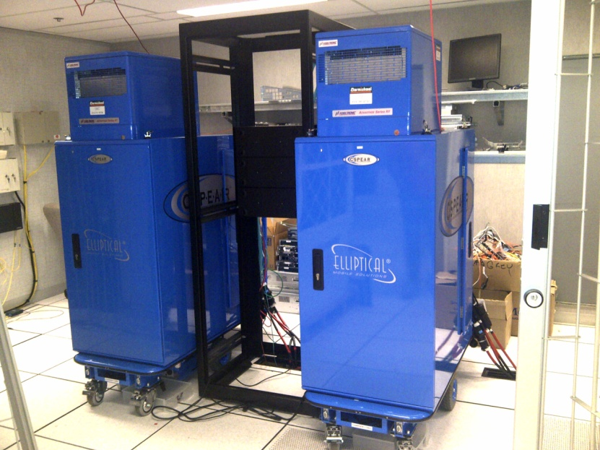
Data Center Retrofit
Canadian Federal Agency
Canadian Federal Agency in need of Data Center Retrofit that could be easily relocated in the future.
Challenges: This Canadian Federal Agency was planning to move out of its leased building within two years. They had already relocated their facility a year earlier and did not want to move their core switches or build a new data center closet for $250,000.
Solution: Deploying two C3-S.P.E.A.R.s with dual cooling allowed the agency to run its entire network throughout Canada. They plan to order additional C3-S.P.E.A.R.s this year to accommodate expanding needs.
Benefits: $150,000 capital savings versus retrofitting current data center; scalability, and the ability to relocate the data center to a new location as planned.
Confidential 2012 – www.ellipticalmobilesolutions.com

Slide 8
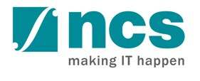
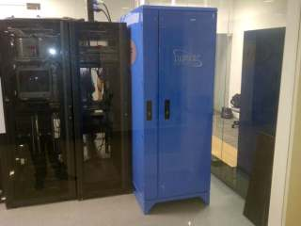
High Density Zone within Data Center
NCS - Singapore
Largest System Integration company in Singapore in need of High Density Zone within existing Data Center.
Challenges: NCS had the requirement to implement high density zones in the their data centers and extend data center space to customers with quick turnaround time, reducing complex and extensive renovations. The deployment sites have no air-conditioning outlets and are not housed on a raised floor.
Solution: NCS bundled the R.A.S.E.R. DX as their value proposition and competitive edge to support clients’ high power density servers as well as to showcase their leadership in the Asia Data Center and Business Continuity Services.
Benefits: Able to host high density equipment in a “DC friendly” environment quickly and cost effectively without extensive or complex renovations, customers will have the ability to relocate the Micro-Modular Data Centers in the future if required to do so.
Confidential 2012 – www.ellipticalmobilesolutions.com

Slide 9

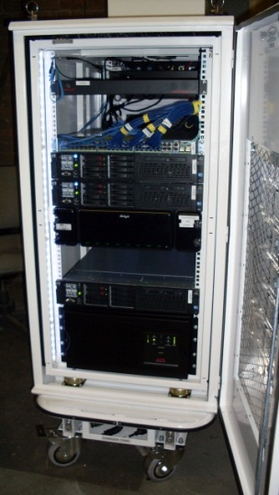
Small Office Data Center
Ecotality
Small, rapidly growing company needed a small data center that could
scale as needed.
Challenges: Ecotality, a leader in clean electric transportation and storage technologies, needed to build a data center closet to support the rapid growth of the company. Ecotality knew that they would need to move buildings due to the rapid growth of their business and wanted a data center that could move with them.
Solution: Deploying the C3-S.P.E.A.R. allowed Ecotality to have a data center in oneof their manufacturing warehouses in under 8 weeks. The C3-S.P.E.A.R. also
provided a “Clean IT” solution consistent with the company’s mission.
Benefits: $120,000 Capex savings by not converting valuable office space into a data closet; rapid deployment; scalability, and the ability to relocate the data center to a new location as the company grows.
Confidential 2012 – www.ellipticalmobilesolutions.com

Slide 10

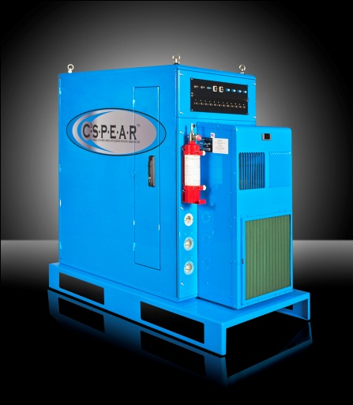
Disaster Recovery
Cardio Vascular Consultants
Large medical group in need of a relocatable disaster recovery solution.
Challenges: Cardiovascular Consultants was in need of a disaster recovery solution, but did not want to use a hosting facility or build a data center closet in a separate location or facility.
Solution: The group purchased a C3-S.P.E.A.R. with a skid cart bottom to house its IT equipment. Located in an empty room in one of its thirteen offices, the enclosure serves as an ideal disaster recovery solution and can easily be relocated to a different location using a pallet jack.
Benefits: Rapid deployment in 8 weeks and under budget; less expensive and more secure than a collocation facility; improved performance and simplified implementation.
Confidential 2012– www.ellipticalmobilesolutions.com

Slide 11

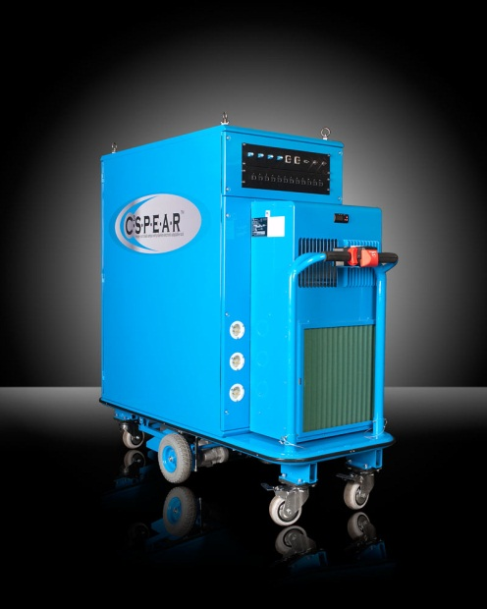
Mobile Coop Site for Disaster Recovery
Connecticut National Guard
Department of US Military in need of mobile Coop
for Disaster Recovery.
Challenges: The Connecticut National Guard needed to have a mobile continuity for operations plan (COOP) for disaster recovery.
Solution: The C3-S.P.E.A.R. provided the perfect platform as it allows a data center to be easily moved while populated with equipment. Cyber security keeps data safe in any operating environment.
Benefits: Rapid deployment; scalability, and the ability to easily relocate the data center to a new location.
Confidential 2012 – www.ellipticalmobilesolutions.com

Slide 12
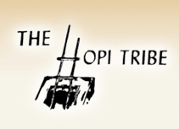

Data Center in a Harsh Environment
Hopi Information Technology Division
Native American Tribe in need of a data center closet/
mobile disaster recovery solution.
Challenges: The Hopi Data Center often experienced IT downtime due to frequent power outages, unreliable backup power generation, flooding during monsoon season, and snow during the winter. The Hopis wanted to have the ability to relocate their environment to their other office in Flagstaff if necessary.
Data Center Retrofit Solution: The Tribe purchased 1 C3-S.P.E.A.R. and 1 C-S.P.E.A.R. which provided it with a secure, reliable and flexible infrastructure to protect their data bases. The mobility feature of the enclosure made it the most practical choice as both enclosures can easily be relocated in the event of severe weather.
Benefits: Rapid deployment in 8 weeks and under budget; drop in place architecture which greatly reduced CapEx and OpEX costs; improved performance and simplified implementation.
Confidential 2012 – www.ellipticalmobilesolutions.com

Slide 13

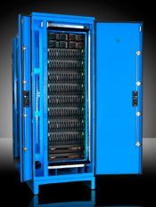
Remote Application Support in a Harsh Environment
Redstone Arsenal
US Military missile testing and deployment site needed a hardened Data Center for remote applications.
Challenges: Redstone Arsenal needed to build a data center for remote applications in a harsh environment. A containerized data center was not practical in terms of cost and size.
Solution: By deploying the NEMA 4 R.A.S.E.R. DX, Redstone Arsenal was able to implement a data center that can operate indoors or outdoors and be moved to another location when needed.
Benefits: Rapid deployment; ease of implementation; space savings; scalability, and mobility.
Confidential 2012 – www.ellipticalmobilesolutions.com

Slide 14

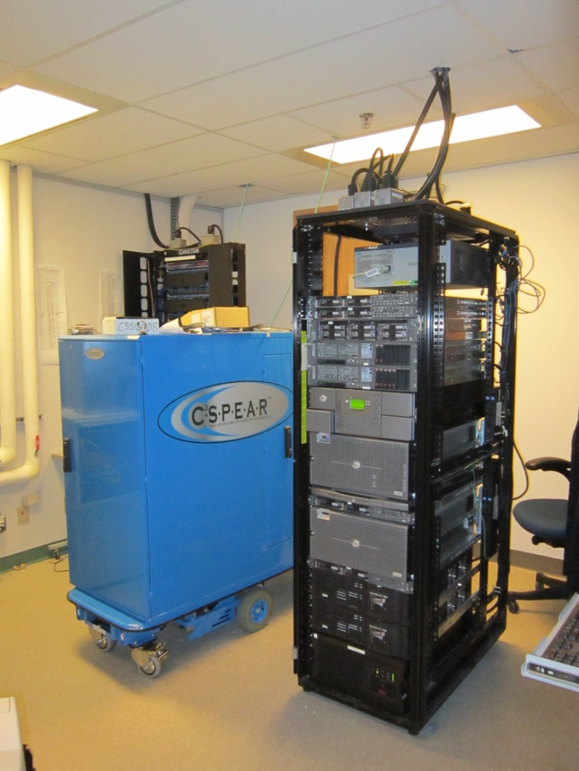
Data Center Retrofit
Patented Medicine
Canadian Medical Board in need of a Data Center Retrofit to resolve cooling problems.
Challenges: Canada’s Patented Medicine Prices Review Board was having problems with its equipment overheating whenever a chiller went out. This was happening on a regular basis.
Solution: Patented Medicine consolidated two of their 19” racks into one 24U C3-S.P.E.A.R. and optimized their I.T. requirements. They plan to consolidate two more of their existing 19 inch racks into a C3-S.P.E.A.R in the future.
Benefits: Eliminated cooling issues for equipment housed in the C3-S.P.E.A.R., rapid deployment; scalability, and the ability to relocate the data center to a new location if necessary.
Confidential 2012– www.ellipticalmobilesolutions.com

